Slide 1
Vault Data Standard Introduction
Marco Mirandola
CEO @ coolOrange

Slide 2
Agenda
Features
CAD dialogs (new/update)
CAD copy/replace
Installation
Setup
Update/Upgrades
Configuration
Categories, properties, mapping
Category filtering
CAD Functional Designs
Vault dialogs (new/update)
Vault tabs
Folder-structure
Logs
PowerShell editing
Dialog design
Resources
Official documentation
Forum
Blogs
Numbering schemes
Numbering scheme filtering
CAD config files
Dynamic properties config
Tools
Bread Crumb
Menus, tabs, dialogs
Debugging
Cascading Drop-downs
Custom Numbering
Customizing
Data Validation

Slide 3
Learning objectives
What is Vault Data Standard (VDS) and what can it do for you/me
How to install and configure VDS
How to customize VDS and according tools
Further resources

Slide 4
Required skills
For the configuration
Vault, AutoCAD, Inventor basic understanding
Vault configuration
XML file editing
For the customization
Basic coding skills
Basic UI skills

Slide 5
What is Data Standard
It’s a free Vault add-on
It standardize data entry
It’s an Autodesk product
It’s supported by Autodesk
It comes with the Vault installation
Supported applications: Vault, Inventor, AutoCAD, AutoCAD Mechanical
Supported Versions: all supported Vault versions

Slide 6
Data Standard Features

Slide 7
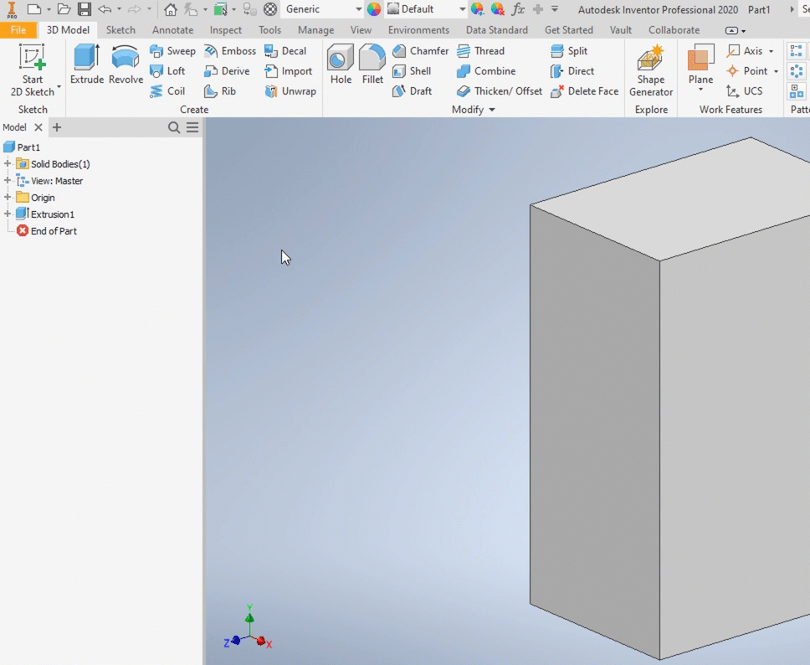
CAD initial save dialog
The Data Standard dialog appears on the initial save of an Inventor or AutoCAD file
It prompts the user to enter required values
Save the file just in the permitted folders
Drive category and numbering scheme

Slide 8
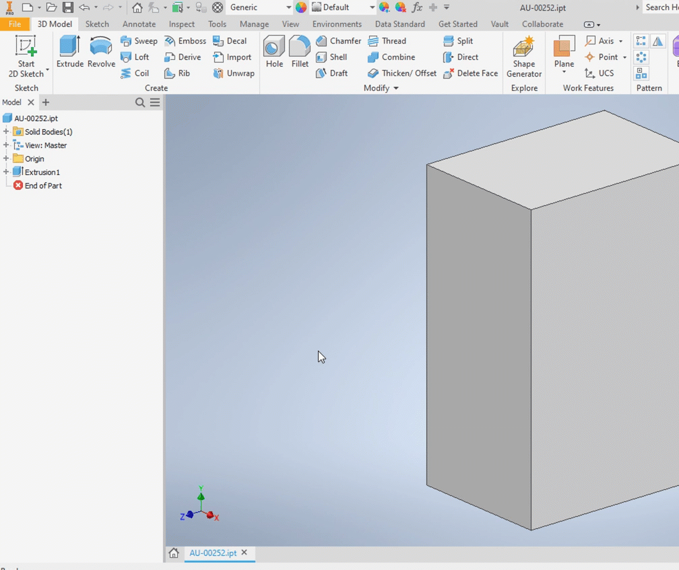
CAD edit properties dialog
After initial save, the properties can be edited at any time
The property entry is subject to the configured property rules
The rules are validated at each save

Slide 9
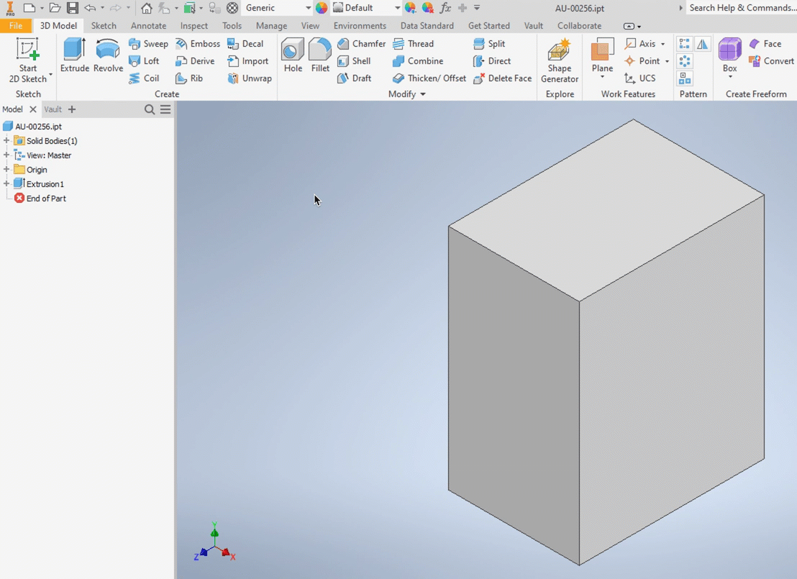
CAD copy w/o drawing
VDS offers a dedicated copy function, which takes care of related drawings

Slide 10
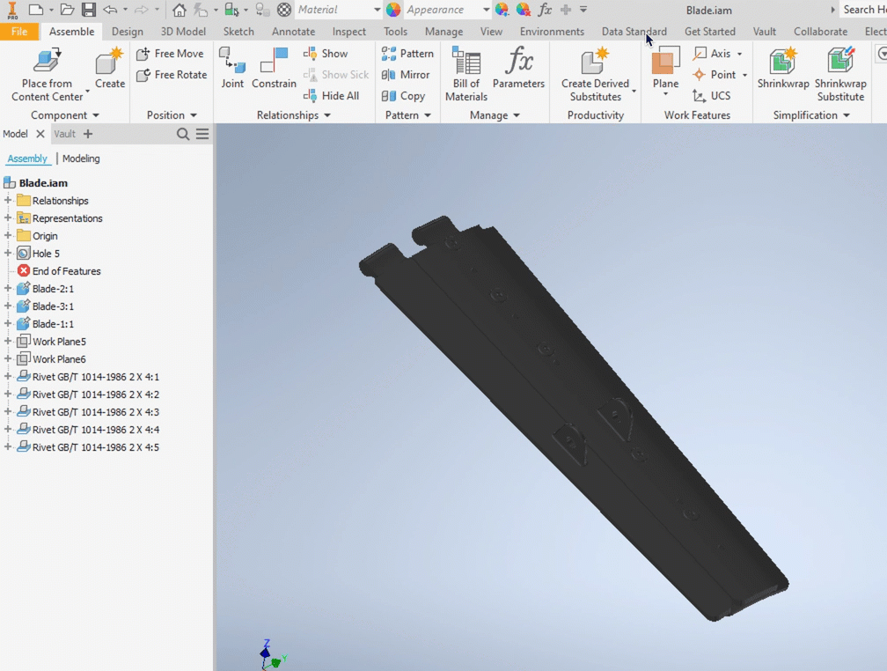
CAD replace by copy
VDS offers a dedicated replace function, which takes care of related drawings

Slide 11
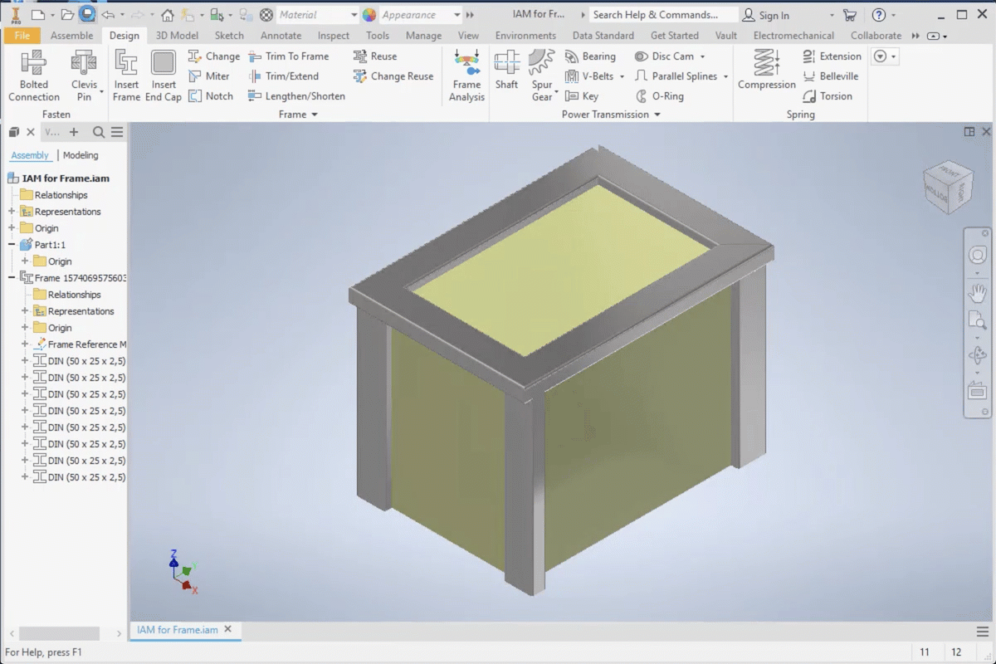
CAD functional designs
VDS offers a dedicated dialog for functional designs, where several components needs to be saved at once

Slide 12
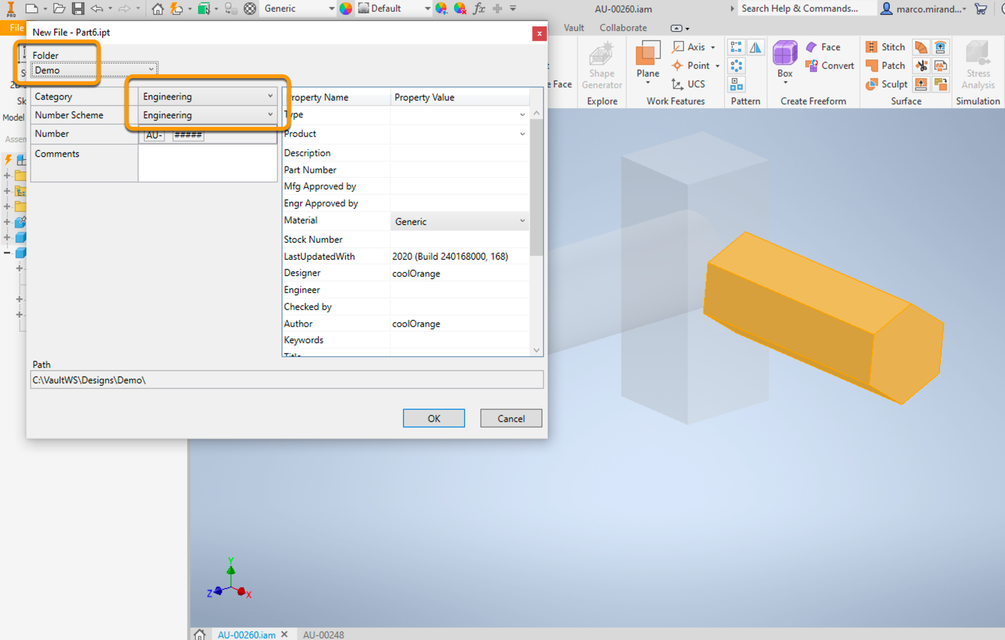
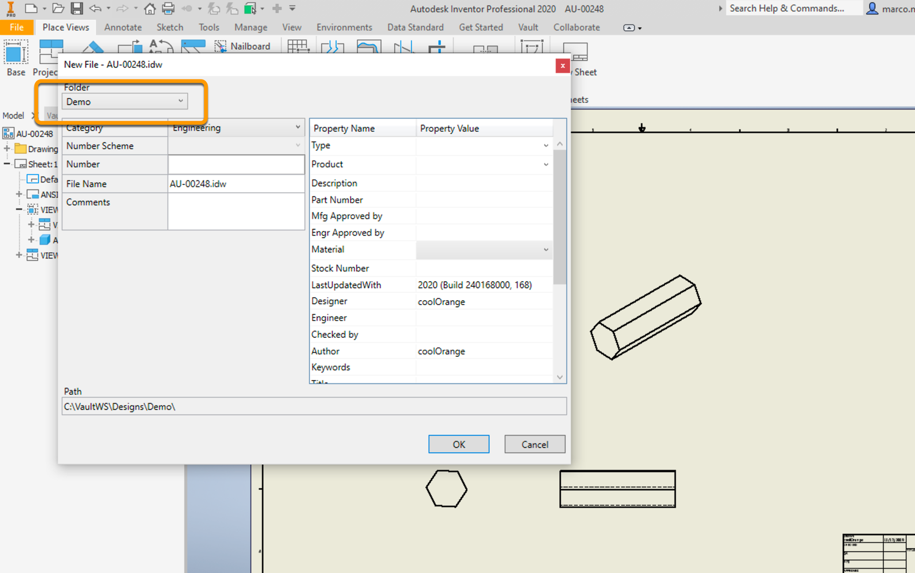
CAD VDS is smart
VDS has some built in behaviors to simplify usability
Once an assembly is saved, new added components will be suggested to be placed into the same folder
When saving a drawing, the suggested folder will be the one from the inserted model
If the numbering scheme name matches a category name, by selecting the category, the numbering scheme will follow

Slide 13
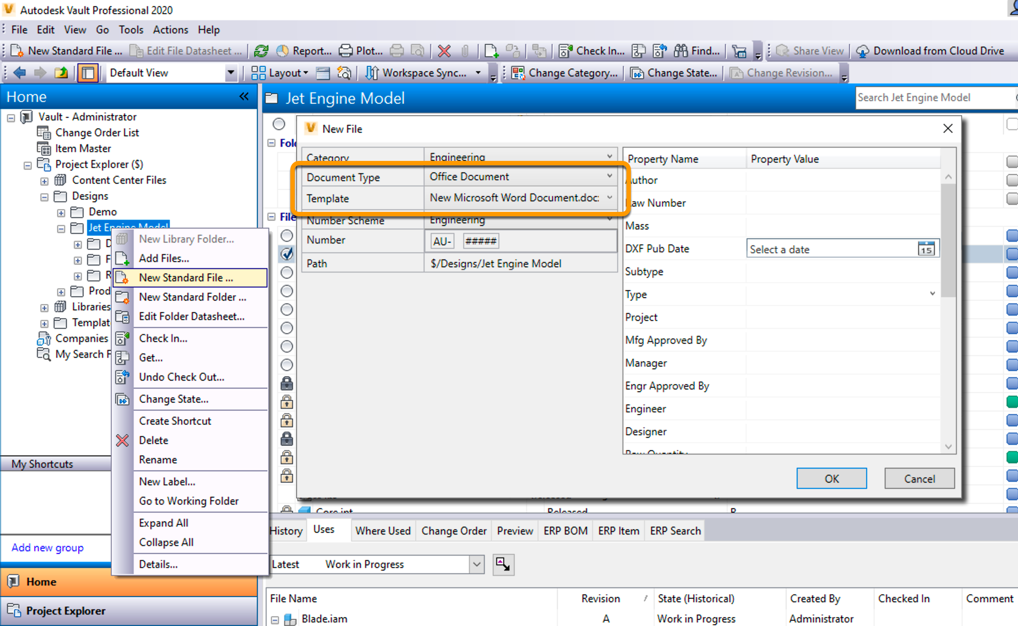
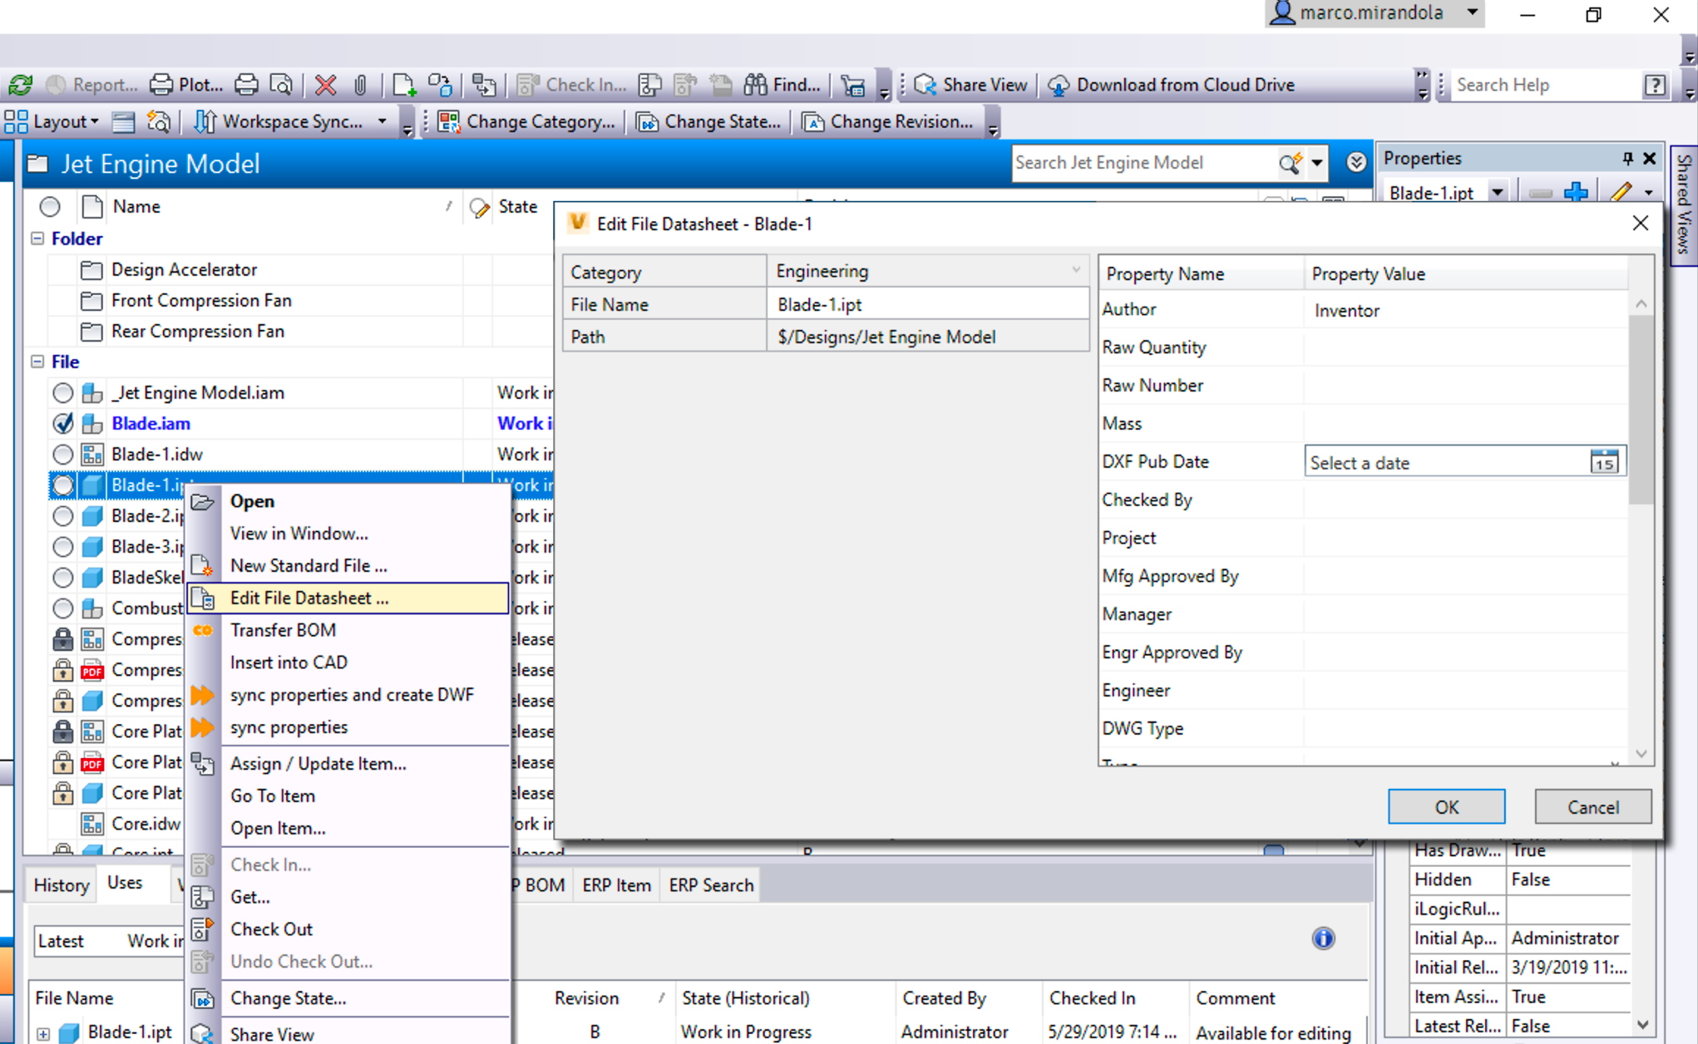
Vault file creation Vault file property editing
File creation dialog for Vault
Create files from a template
Edit properties

Slide 14
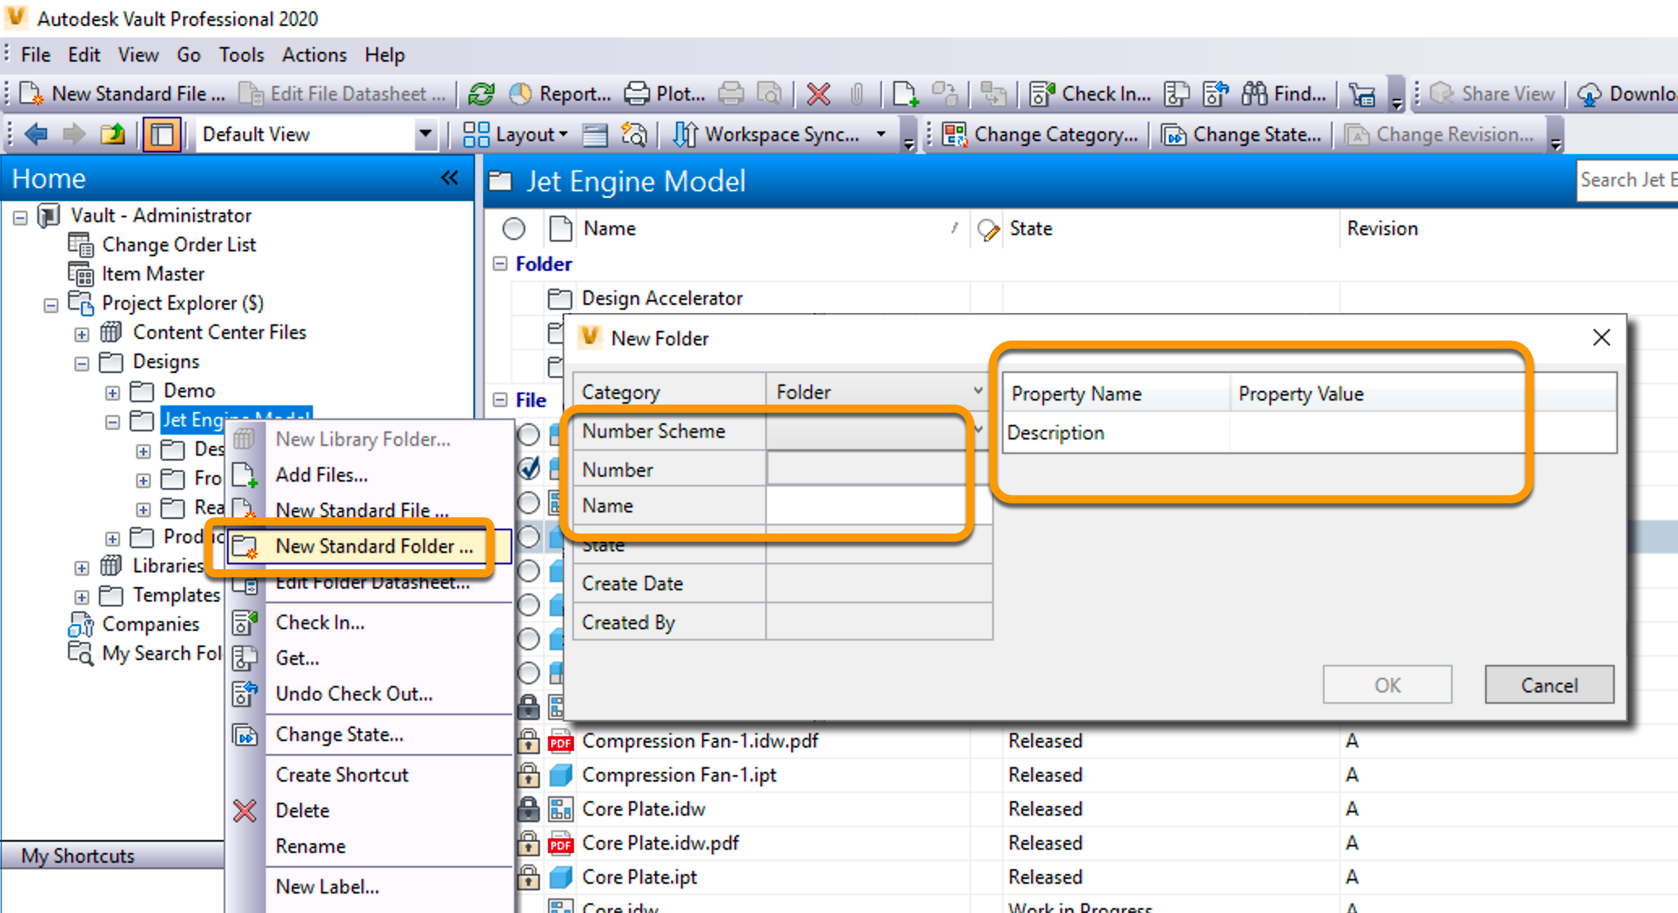
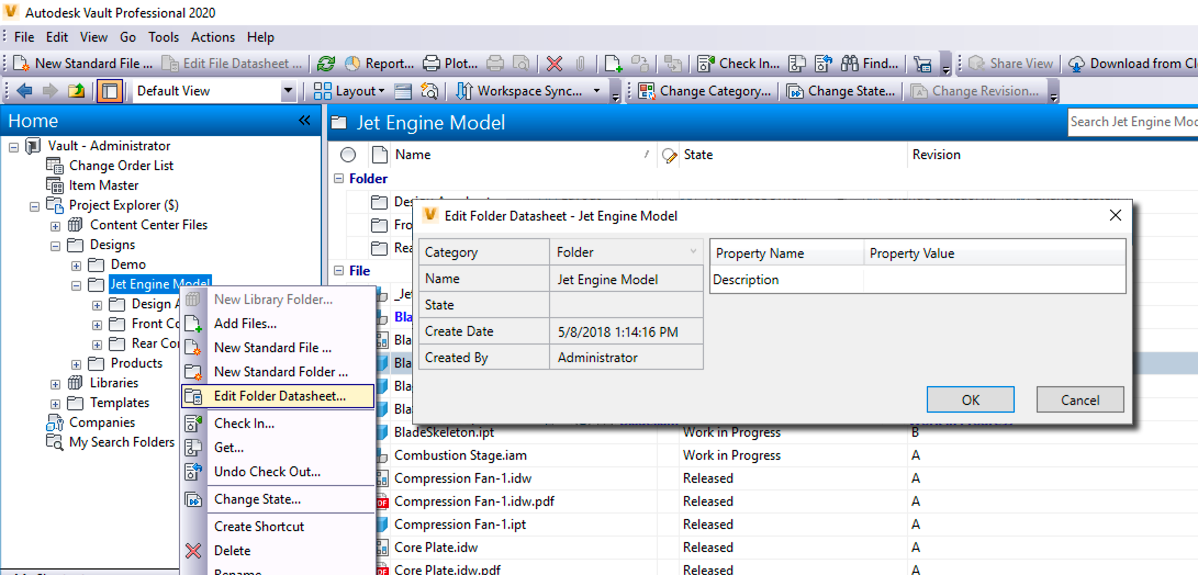
Vault folder creation Vault folder property editing
Folder creation dialog for Vault
Numbering for folders
Edit properties

Slide 15
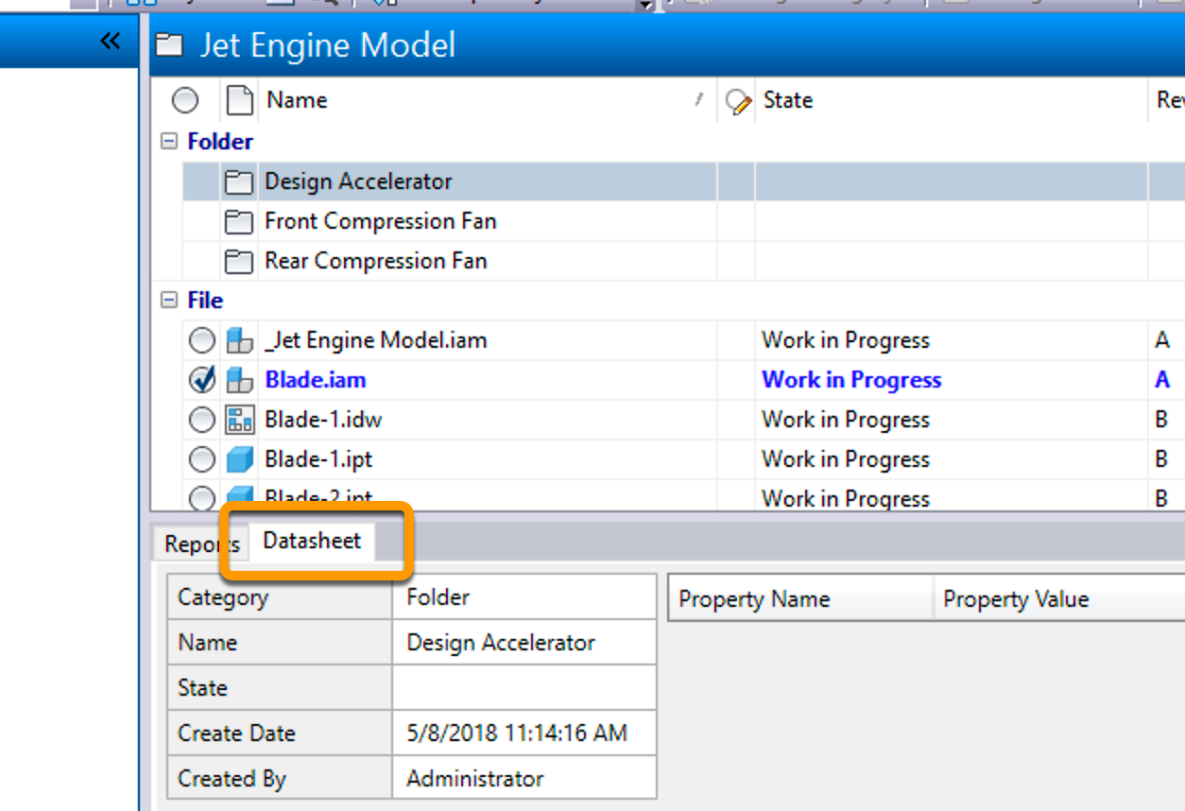
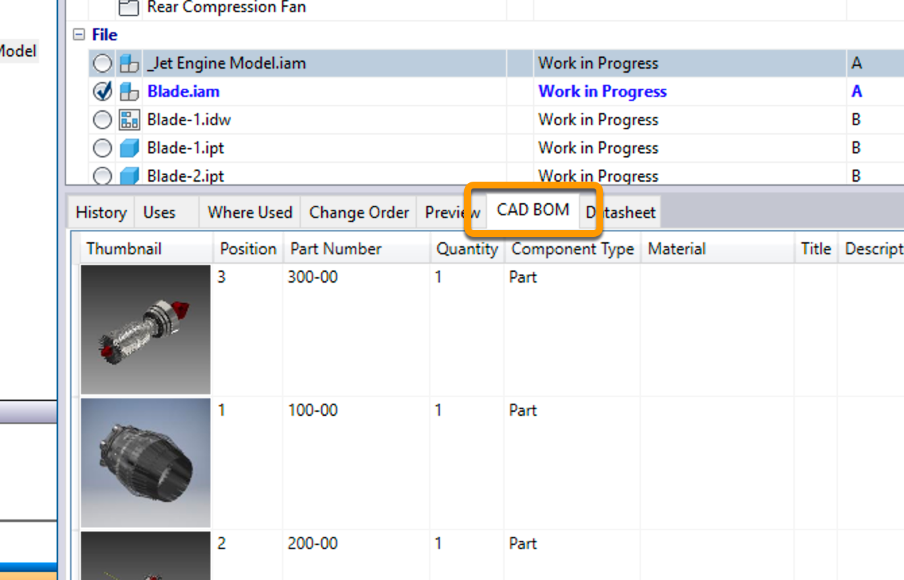
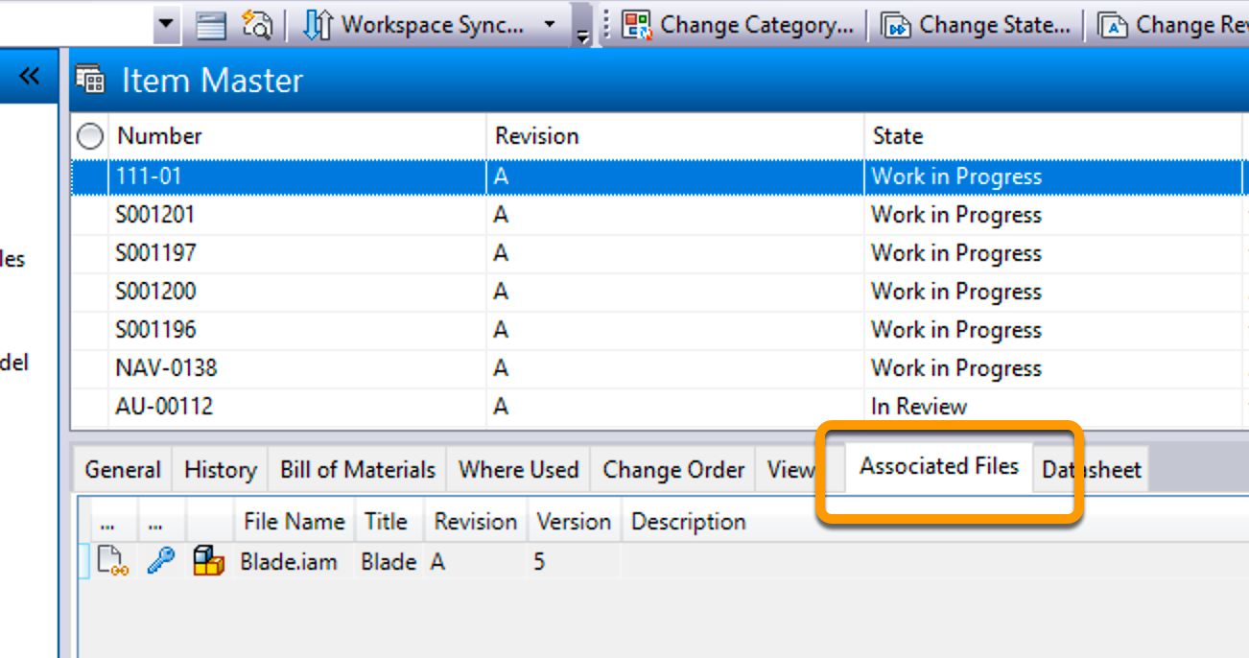
Vault tabs
Datasheet for files, folders, items, change order, custom objects
CAD BOM preview for files
Related files dialog for items

Slide 16
Data Standard Installation/Upgrade

Slide 17

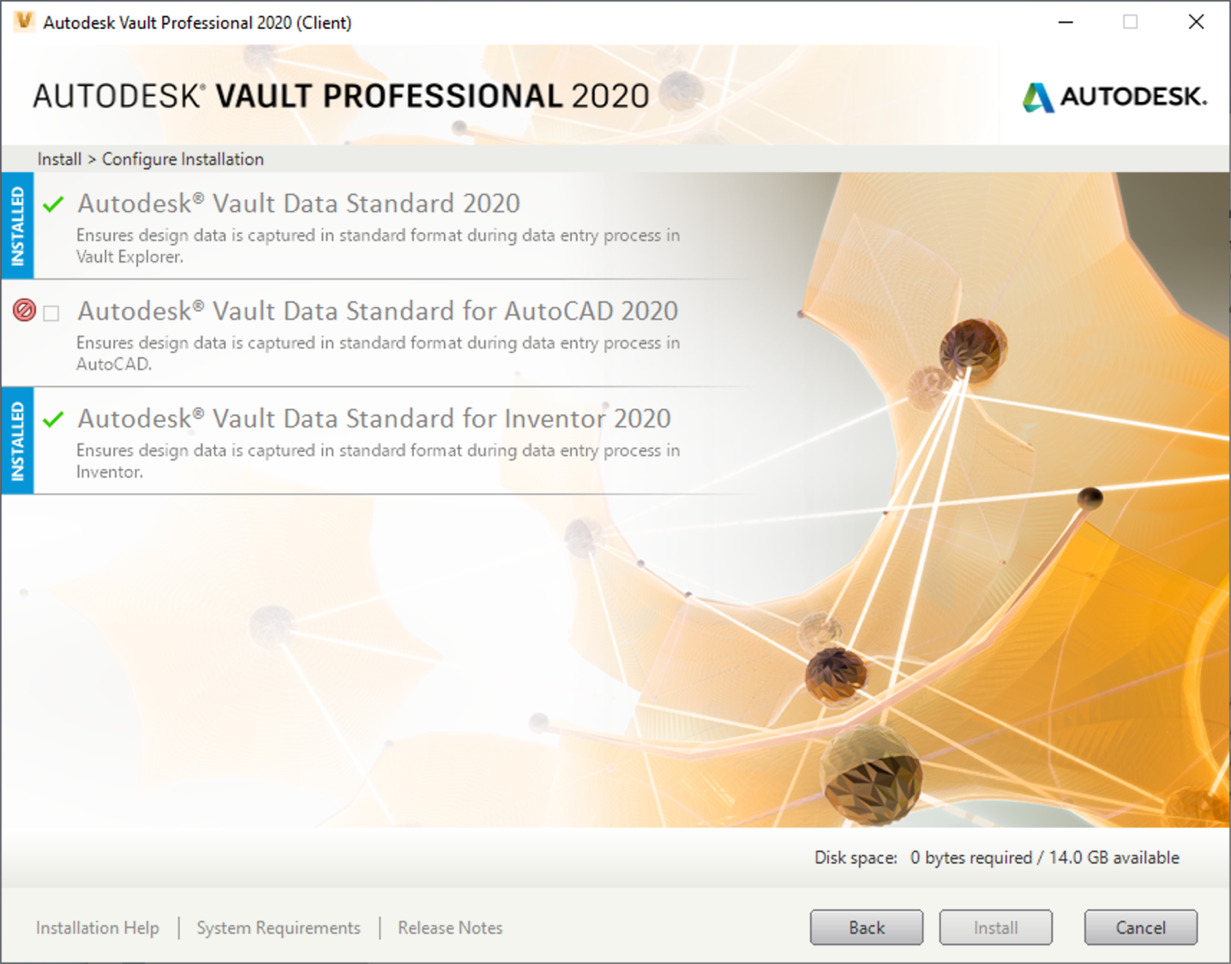
VDS installation
VDS is part of the Vault client setup since Vault 2019
3 separate installer for Vault, AutoCAD, Inventor
https://knowledge.autodesk.com/support/vault-products/troubleshooting/caas/CloudHelp/cloudhelp/2019/ENU/Vault-Install/files/GUID-EF14D3BA-EC42-4388-A0A5-BCEB3BC3A411-htm.html

Slide 18
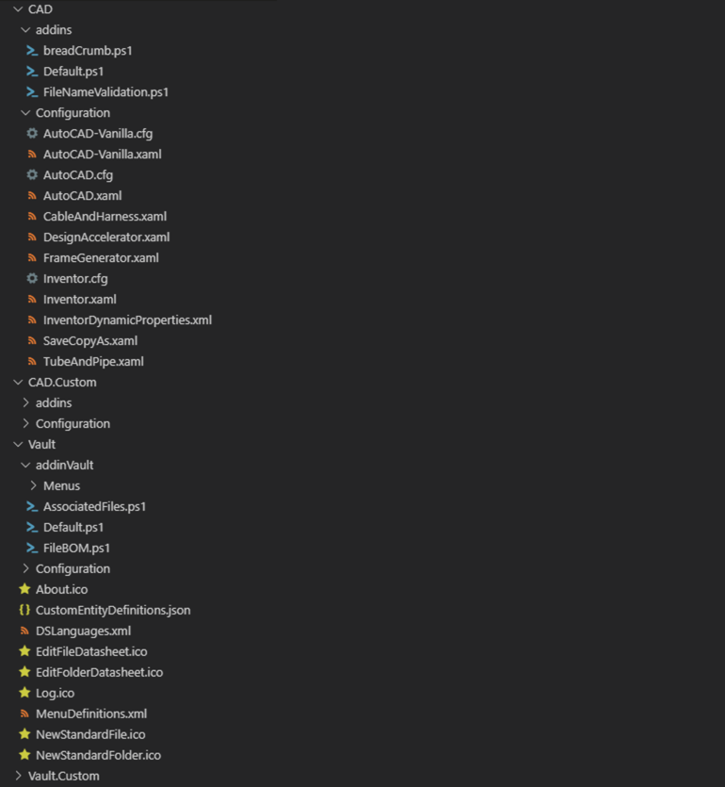
VDS Folder Structure
PowerShell files business logic
C:\ProgramData\Autodesk\Vault <Verion>\Extensions\DataStandard
Folder for CAD and for Vault
Split between default and custom
Folder contains a
code area (addins)
config area (Configuration)
UI (XAML) files config files
Custom folders
Demo

Slide 19
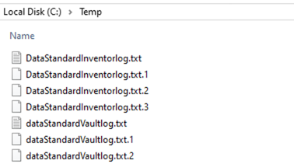
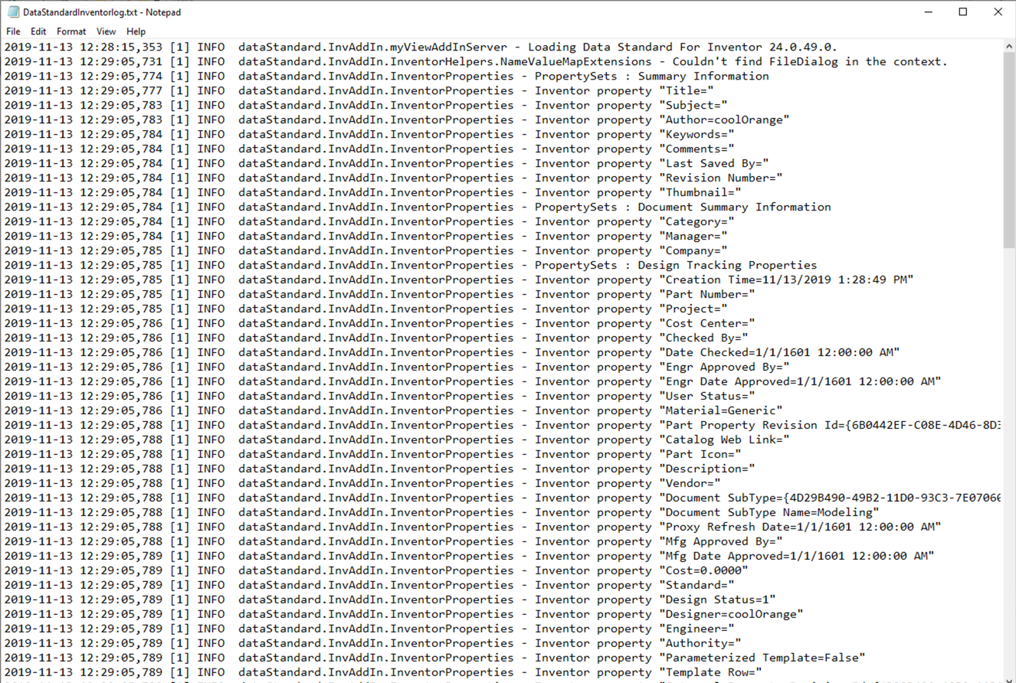
VDS Logs
All logs file are under C:\temp\
Change log behavior
C:\ProgramData\Autodesk\Inventor 2019\Addins\Data Standard\dataStandard.InvAddin.dll.log4net
C:\ProgramData\Autodesk\ApplicationPlugins\Autodesk DataStandard 2019.bundle\Contents\dataStandard.ACadAddIn.dll.log4net
C:\ProgramData\Autodesk\Vault 2019\Extensions\DataStandard\dataStandard4Vault.dll.log4net

Slide 20
VDS Update
Since Vault 2018.1 all customizations shall be in the .Custom folders
Run the setup for an update

Slide 21
VDS Upgrade
Run the setup for an upgrade
Copy the .Custom folder to the new location
Compare your .Custom with the default folder and apply the modifications
Menu file
XAML
PowerShell

Slide 22
Data Standard Configuration

Slide 23
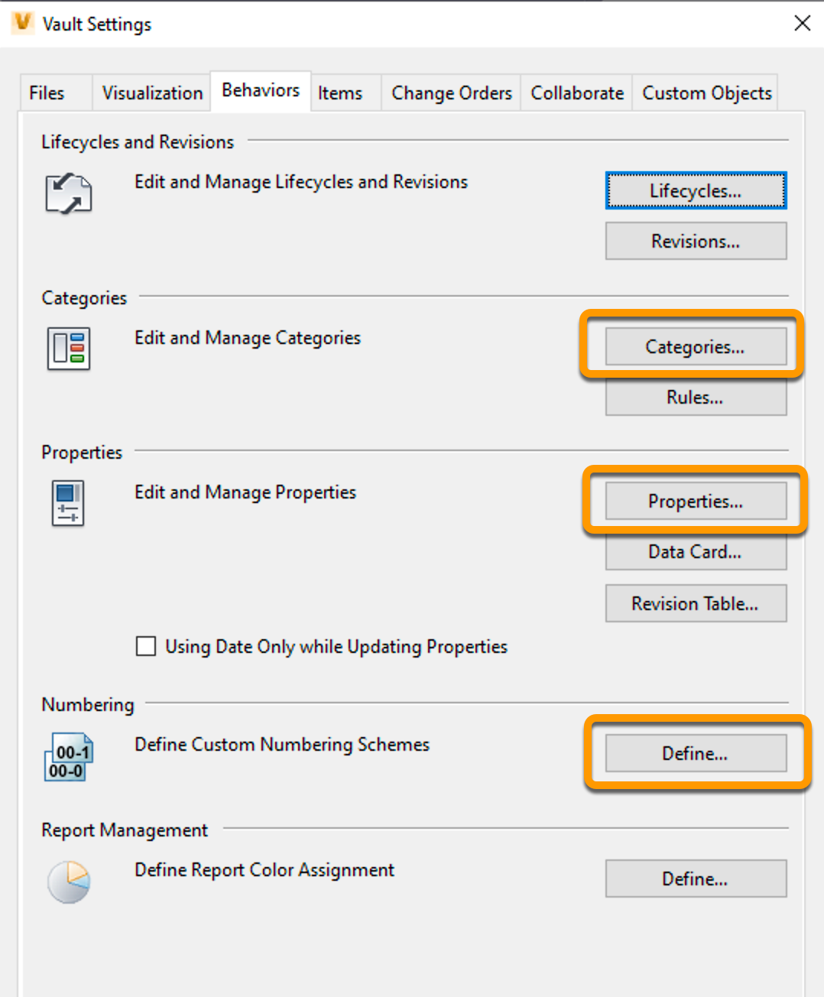
Configure your Vault!!!
Categories
Properties
Mapping (CAD)
Numbering schemes
Demo

Slide 24
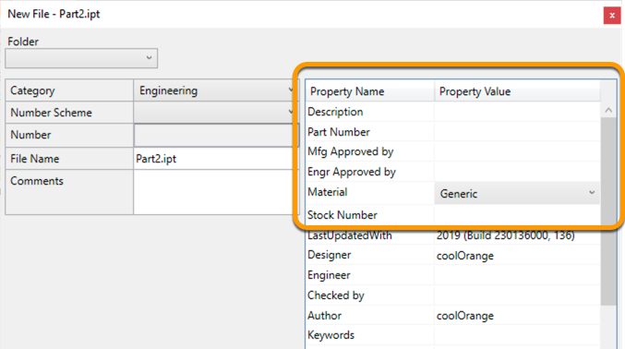
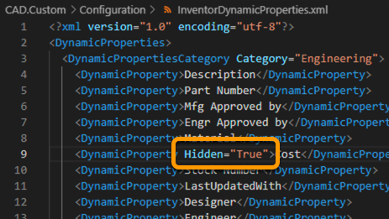
Dynamic properties
Create a file in all required categories in order to generate the following XML files
Define property order and visibility
InventorDynamicProperties.xml
AutoCadDynamicProperties.xml
VaultDynamicProperties.xml
https://blog.coolorange.com/2015/08/21/data-standard-dynamic-properties/
Demo

Slide 25
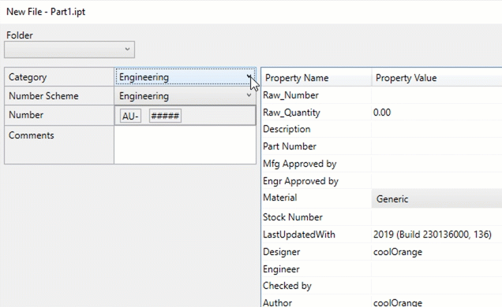
File numbering
Configure your Vault
Create numbering schemes which match category names
Demo

Slide 26
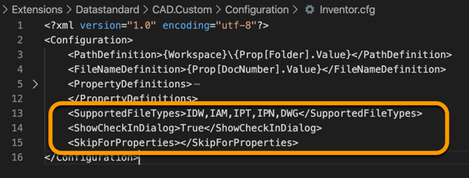
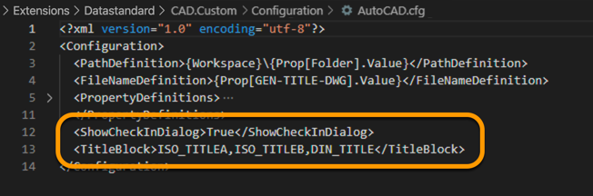
CAD config files
Copy the config file into the CAD.Custom\Configuration folder
Configure your CAD VDS
Supported file types (SupportedFileTypes)
Skip special files (SkipForProperties)
Check-in after save (ShowCheckInDialog)
http://help.autodesk.com/view/VAULT/2020/ENU/?guid=GUID-35BE7DEF-C918-4298-9606-F999F4CC4D02

Slide 27
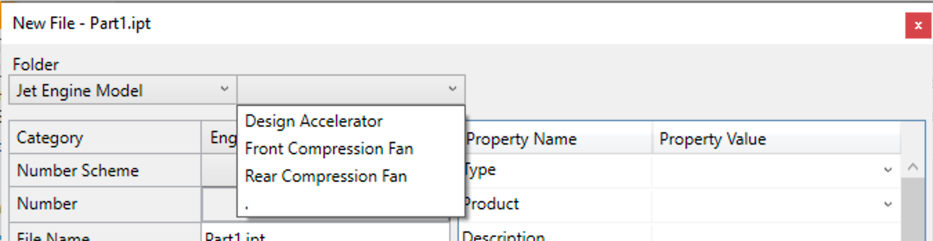
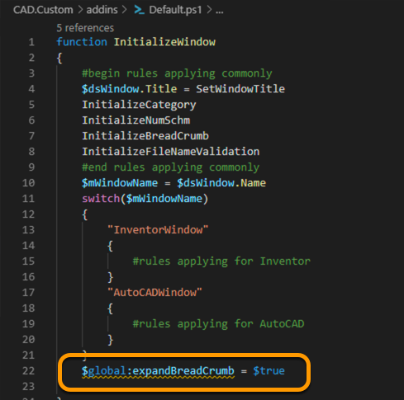
CAD bread crumb behavior
Configure whether the bread crumb shall be automatically expanded or not
Create a new Default.ps1 in the CAD.Custom\addins folder
Copy the function InitializeWindow from the standard Default.ps1 to the custom
Modify the variable $global:expandBreadCrumb to either $true or $false

Slide 28
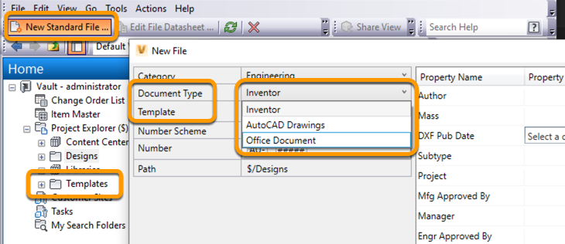
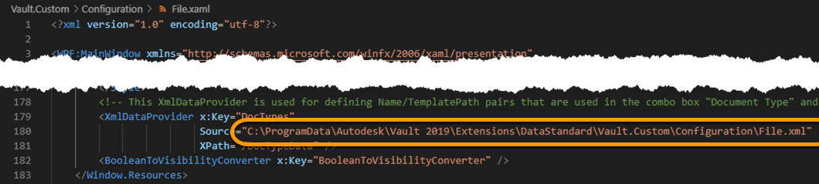
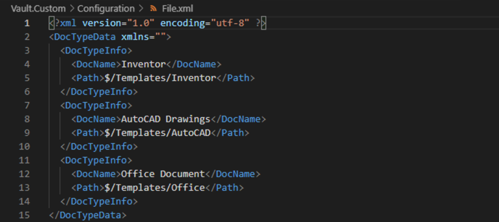
Vault templates configuration
Copy the file.xaml and file.xml into the .Custom folder
Modify the path to the file.xml in the file.xaml
Configure the file.xml
Create the folders inside Vault and add the template files
http://help.autodesk.com/view/VAULT/2020/ENU/?guid=GUID-DBDC927B-269D-4552-AECF-37CEDE0AE326

Slide 29
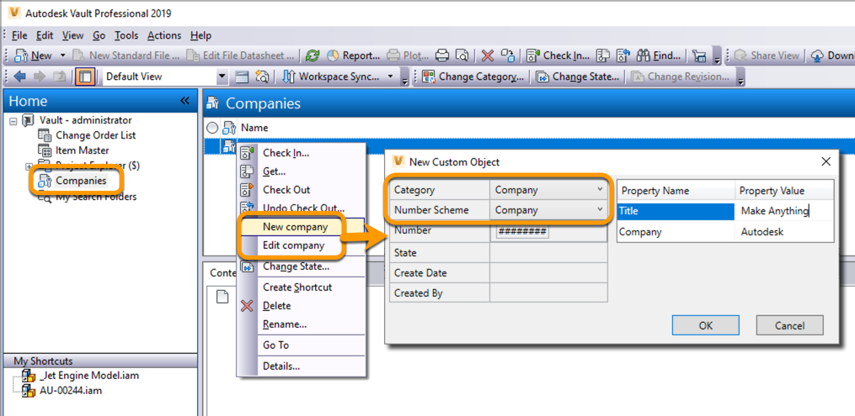
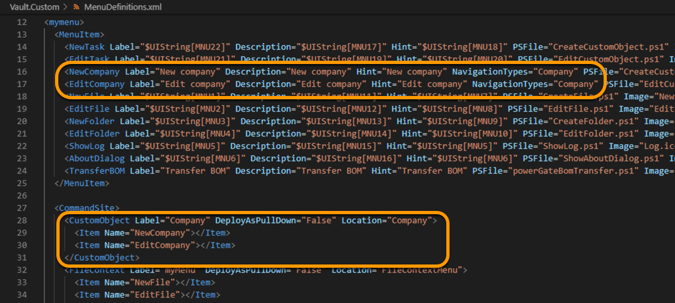
Custom objects
Create a custom object
Define a category with same name
Create a numbering scheme with same name
Assign properties to the category
Create in the MenuDefintion.XML new menu item entries
http://help.autodesk.com/view/VAULT/2020/ENU/?guid=GUID-E853B96F-4B6C-425A-BA32-DE858E1AA6DF

Slide 30
Data Standard Customization

Slide 31
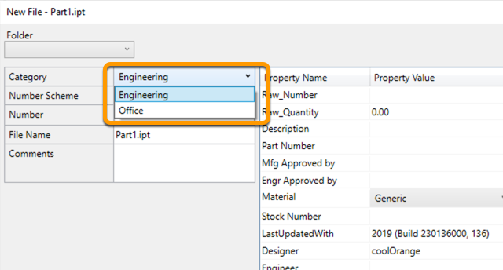
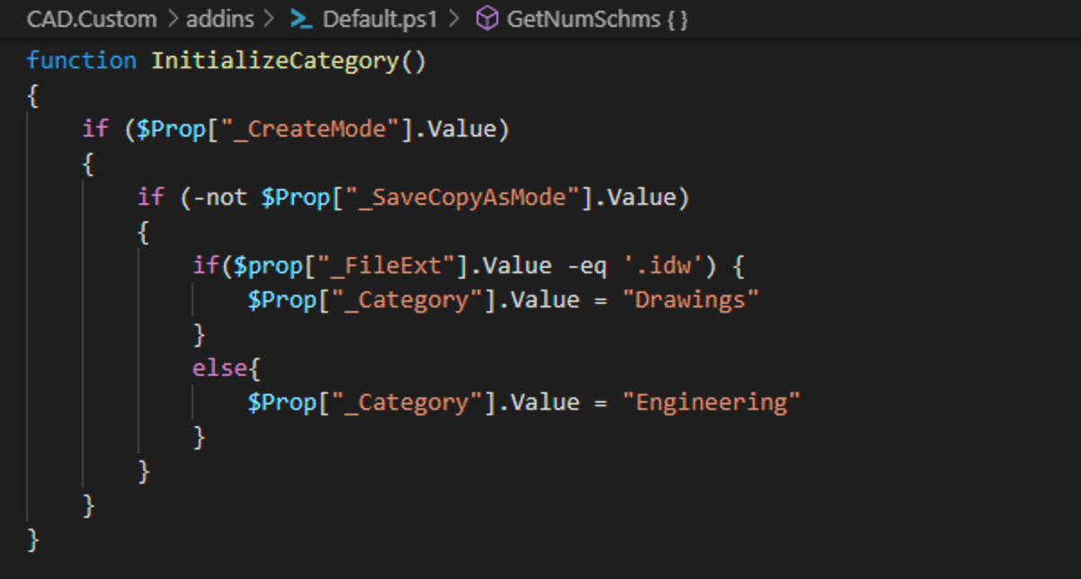
Default category
Define default category
Copy the function InitializeCategory into a custom PowerShell script
Change the business logic
Demo

Slide 32
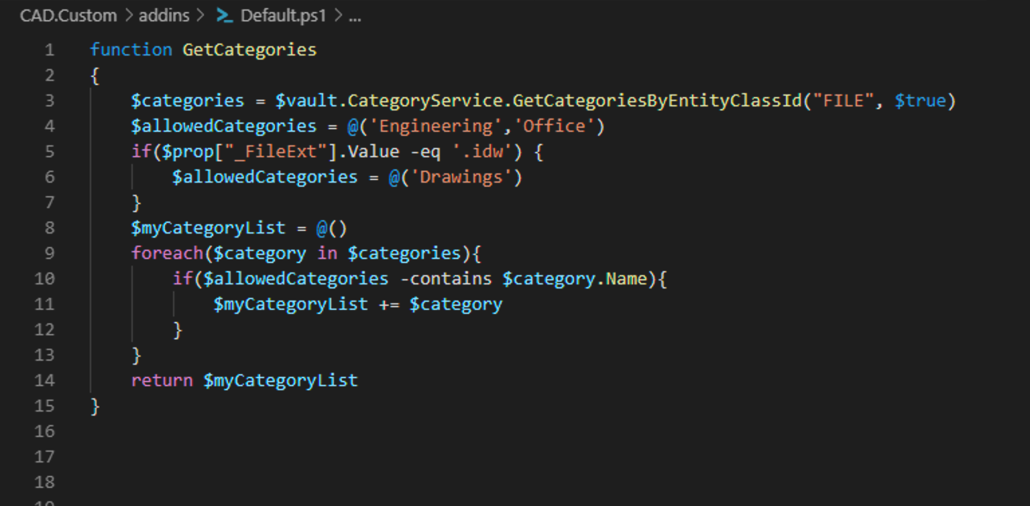
Custom category list
Filter the list of categories
Copy the function GetCategories into a custom PowerShell script
Change the business logic

Slide 33
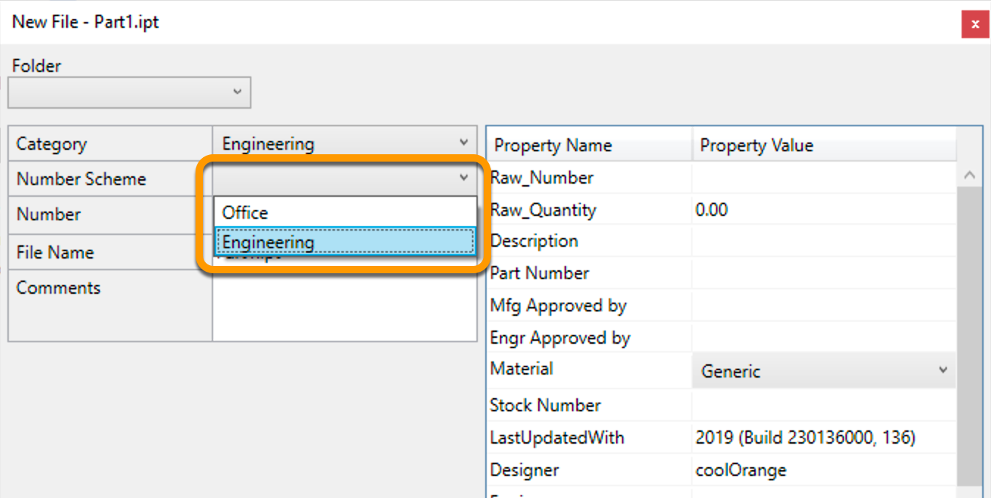
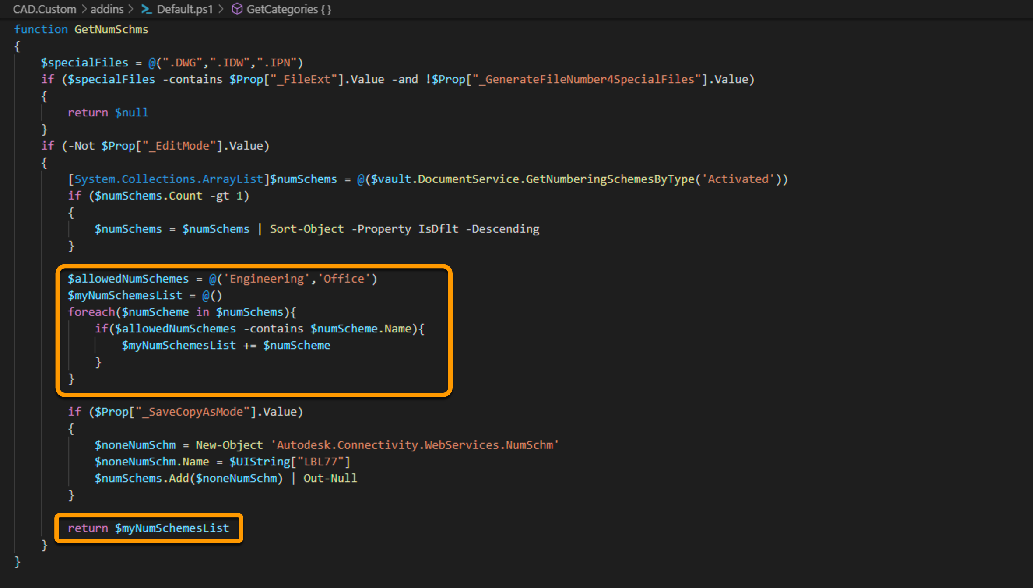
Custom numbering scheme list
Filter the list of numbering schemes
Copy the function GetNumSchms into a custom PowerShell script
Change the business logic

Slide 34
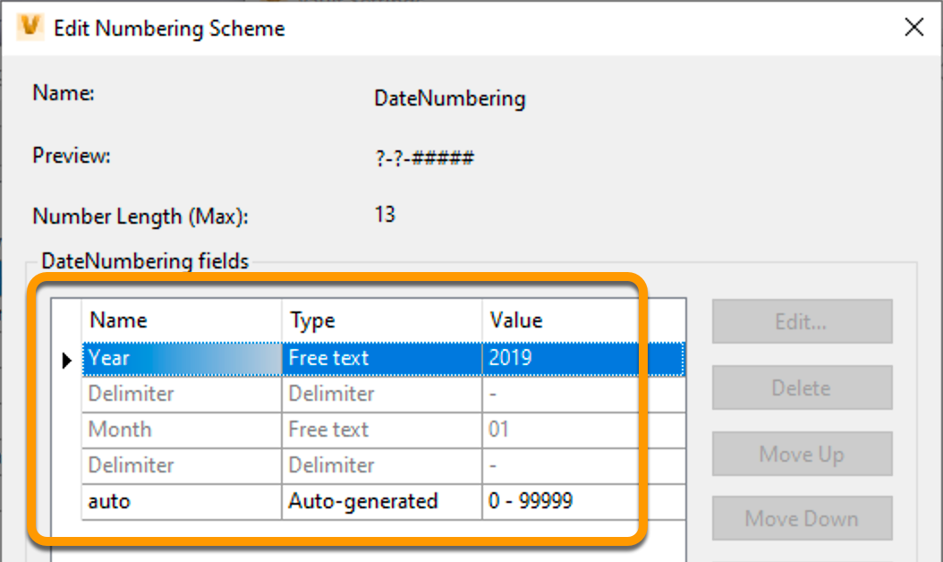
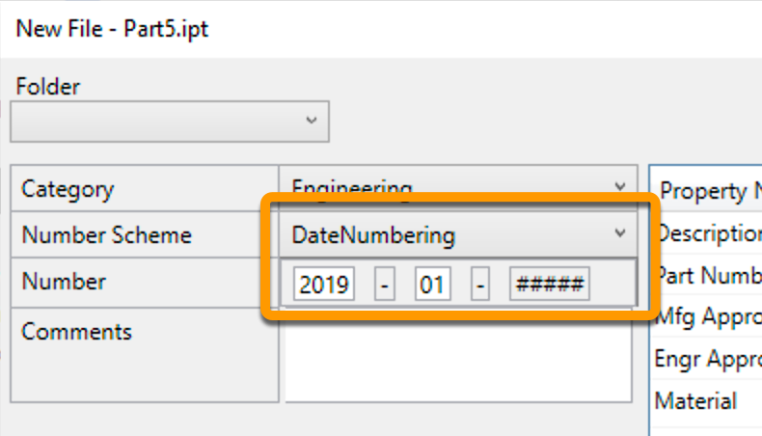
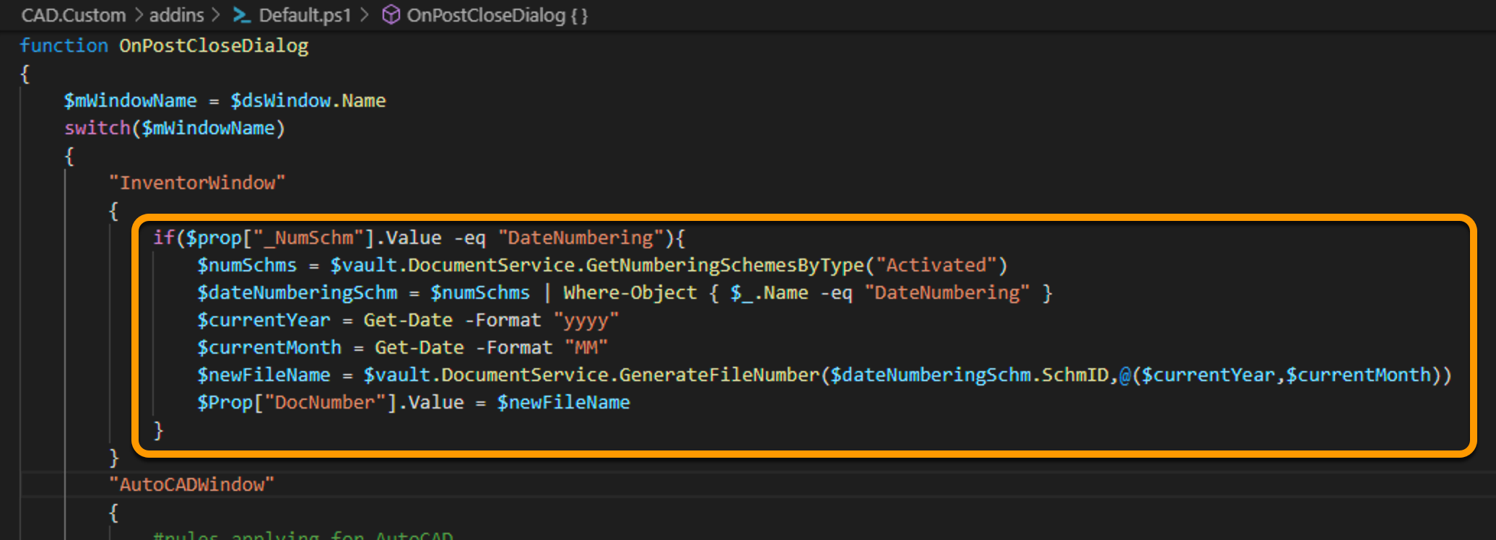
Custom numbering
Numbering scheme with dynamic values
i.e. Numbering scheme with Year and Month

Slide 35
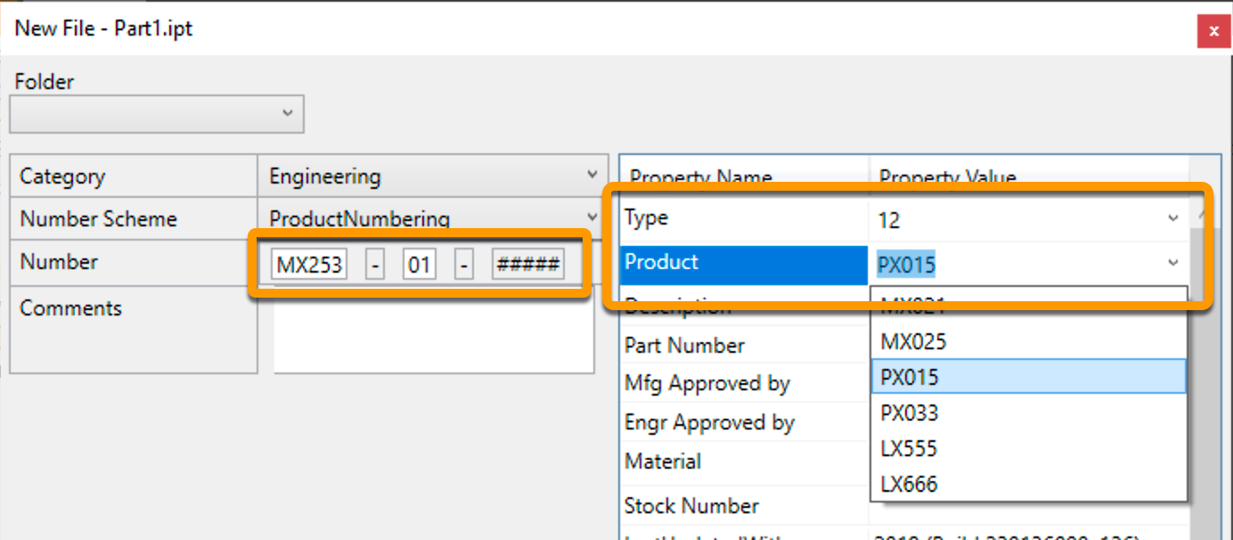
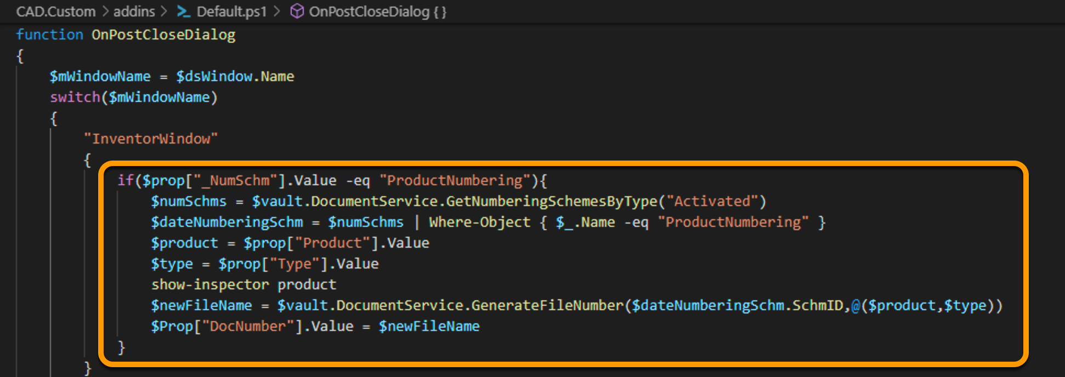
Custom numbering
Numbering scheme with dynamic values
i.e. Numbering scheme by Product and Type

Slide 36
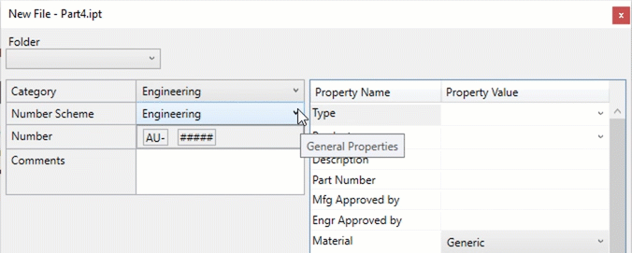
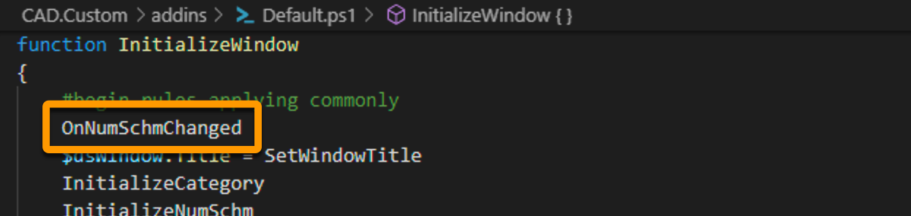
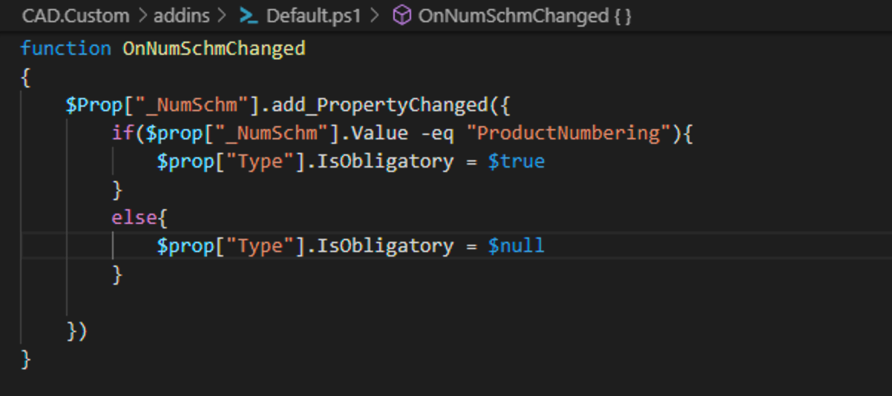
Change property behavior
Change dynamically/programmatically the property behaviors
i.e. make a property obligatory depending on the selected numbering scheme

Slide 37
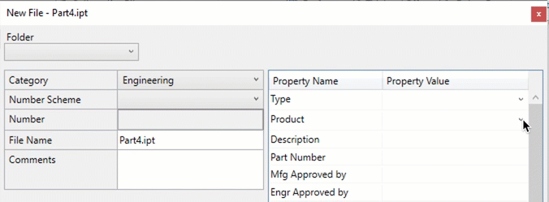
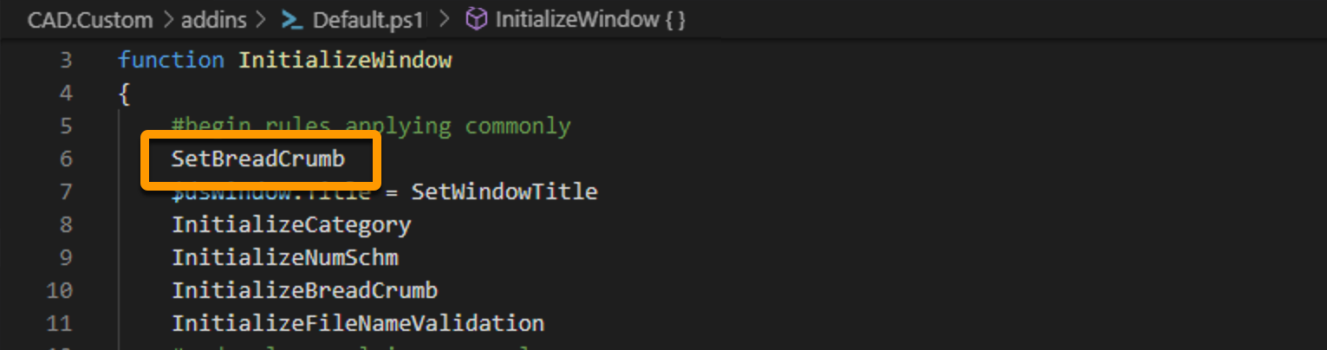
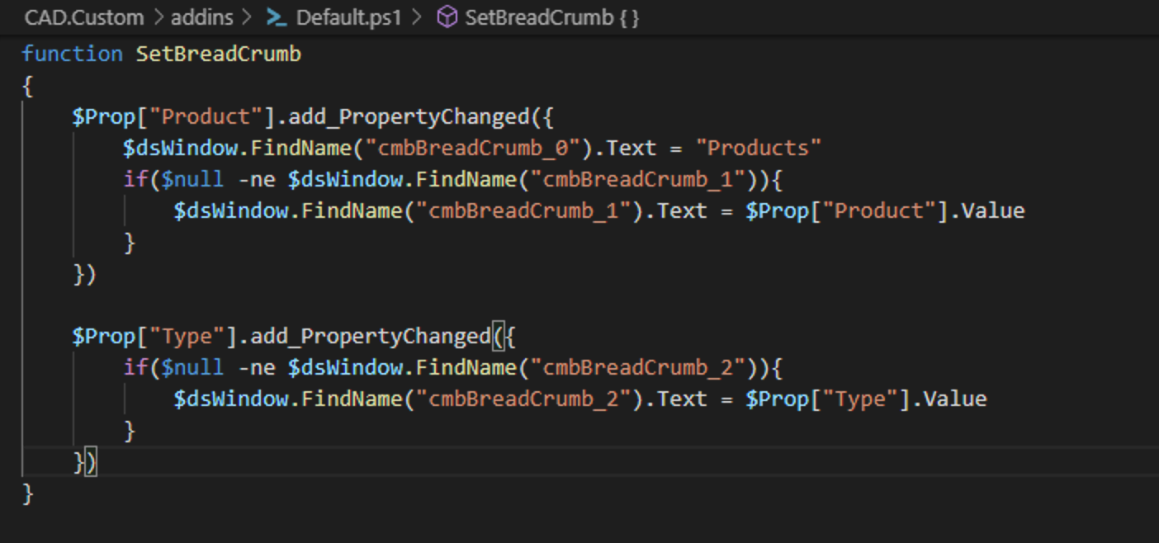
Set the bread crumb
Change dynamically/programmatically the property behaviors
i.e. make a property obligatory depending on the selected numbering scheme

Slide 38
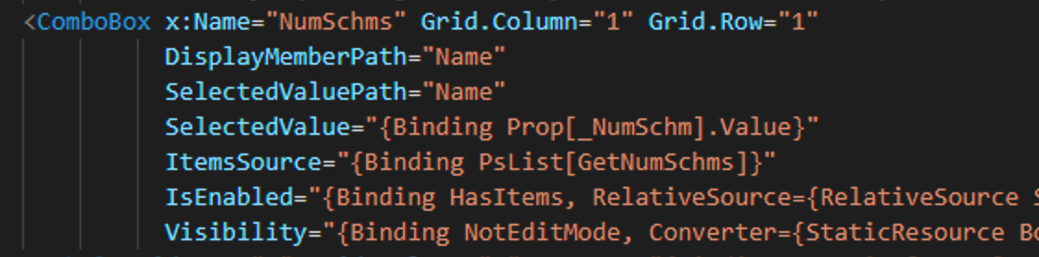
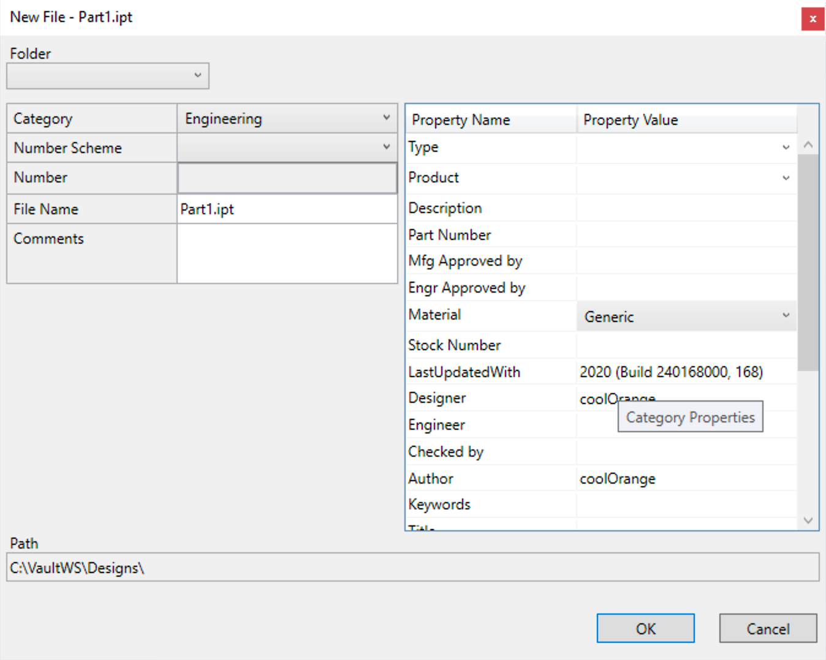
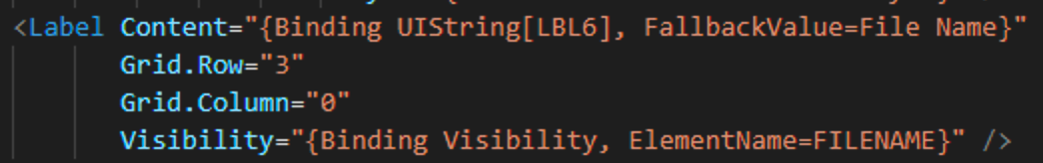


Introduction in XAML

Slide 39





Introduction in XAML

Slide 40



Customize the UI
Move a property from the dynamic property grid to the main area
Copy the XAML file to the custom folder
Add Label and TextBox to the according Grid
Hide the Property from the Dynamic Property area
Demo

Slide 41


Customize dialogs
Extend the dialog’s capabilities
Example “Select from custom objects”

Slide 42



Customize dialogs
Extend the dialog’s capabilities
Example “Cascading drop down”

Slide 43




Custom menu items
Example “Copy folder structure”
Copy the MenuDefinitions.xml into the Custom folder and apply changes

Slide 44


Suppress menus
At the end of the MenuDefinition.xml, the section SuppressMenuItems holds the list of menus to be removed
The list of all menus is hold in the variable vaultContext.Application.CommandIds

Slide 45



Create new tabs
Copy the Datasheet.XAML to your custom folder
Rename the file and apply changes

Slide 46



Buttons
Create a Button and bind your Command to a PowerShell function
Command="{Binding PsCmd[YourFunction]}”
Write your PowerShell function

Slide 47
Coding Techniques

Slide 48

How to find the right code
With vapiTrace you can monitor the Vault client -> server communication and identify the appropriate API calls and parameters

Slide 49
Add_OnPropertyChanged
In order to react when the value of a property changes and execute some custom business logic
$Prop["PropertyName"].add_PropertyChanged({
Write your custom code here ...
})

Slide 50
FindName
In order to modify a UI element from the code
$dsWindow.FindName("NameOfTheUiElement")
Al the properties the given UI element has, are now accessible via PowerShell
i.e. $dsWindow.FindName("NameOfTheUiElement").IsEnabled = $false

Slide 51

Debugging
$dsDiag.Clear()
$dsDiag.Trace("my message")
$dsDiag.ShowLog()
$dsDiag.Inspect()

Slide 52


Errors in dialogs (XAML)
Upper/Lower cases
Wrong attributes
Missing quote elements
Missing brackets

Slide 53


Errors in PowerShell
Logic error
Syntax error
Missing brackets / quotes

Slide 54
Editors

Slide 55


For PowerShell editing
PowerShell ISE
Visual Studio Code

Slide 56

For UI editing
Visual Studio
https://blog.coolorange.com/2015/07/24/editing-data-standard-2016-files-with-visual-studio/

Slide 57
Where to find help
Autodesk knowledge base for official documentation
http://help.autodesk.com/view/VAULT/2020/ENU/?guid=GUID-5030830E-69F8-4A57-ABE4-D1D430C58F95
Autodesk Vault forum for help
https://forums.autodesk.com/t5/vault-customization/bd-p/301
Your reseller
coolOrange blog
http://blog.coolOrange.com

Slide 58

Download this material
https://github.com/coolOrangeLabs/DataStandardTrainingMaterial

Slide 59


15 minutes for a chance at some Autodesk Bling and a $200 Amazon gift card?
Take the Data Management/Collaboration Survey
Just follow this link!
https://www.surveymonkey.com/r/AU2019CollabSurvey
Don’t forget to include your name and contact information for a chance to win**
Drawing will be held at 2:00 PT on Thursday, November 21st
**Must pick up prize in person (more info in the survey)
***Autodesk employees, Autodesk Partners (Resellers, SI’s, ADN, etc.) are not eligible

Slide 60
Autodesk and the Autodesk logo are registered trademarks or trademarks of Autodesk, Inc., and/or its subsidiaries and/or affiliates in the USA and/or other countries. All other brand names, product names, or trademarks belong to their respective holders. Autodesk reserves the right to alter product and services offerings, and specifications and pricing at any time without notice, and is not responsible for typographical or graphical errors that may appear in this document.
© 2019 Autodesk. All rights reserved.

